Slide 1
State Transition Testing
Presented by :
Muhammad Sohail (02-131192-083)
Adil Waheed (02-131192-082)

Slide 2
What is State Transition Testing?
State Transition testing, is a black-box testing technique, in which outputs are triggered by changes to the input conditions or changes to the 'state' of the system.
In other words, tests are designed to execute valid and invalid state transitions.

Slide 3
WHERE State Transition Testing IS USED?
When we have a sequence of events that occur and associated conditions that apply to those events.
When the proper handling of a particular event depends on the events and conditions that have occurred in the past.
It is used for real-time systems with various states and transitions involved.

Slide 4
When IS State Transition Testing done?
To test the behavior of the system under varying input.
To test the dependency on the values in the past.
To test the change in the transition state of the application.
To test the performance of the system.

Slide 5


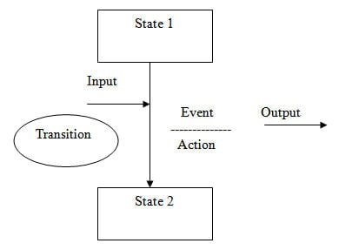
What is a state transition diagram?
State Transition Diagram shows how the state of the system changes on certain inputs. It has four main components:
States
Transition
Events
Actions

Slide 6
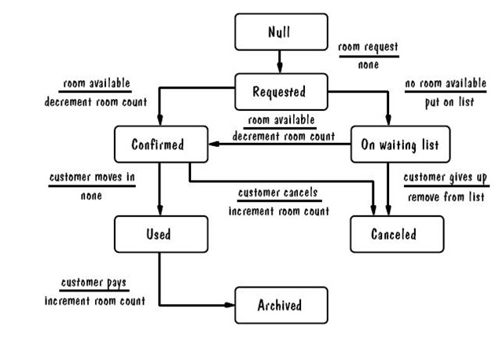
Example#1: Rent a room

Slide 7
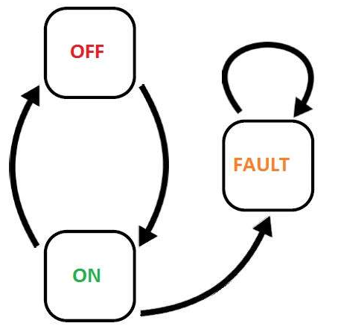
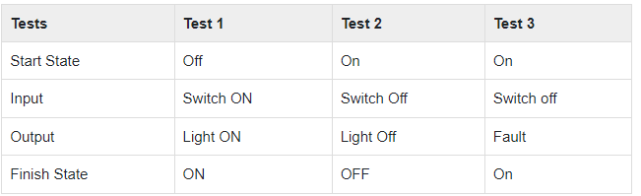
Example#2

Slide 8
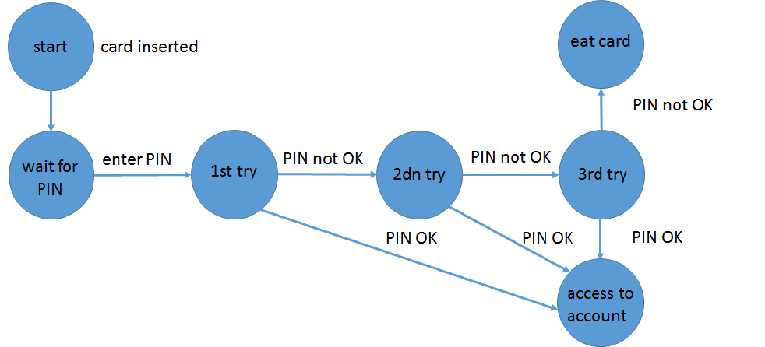
ExamPle#3: PIN TESTING IN ATM

Slide 9
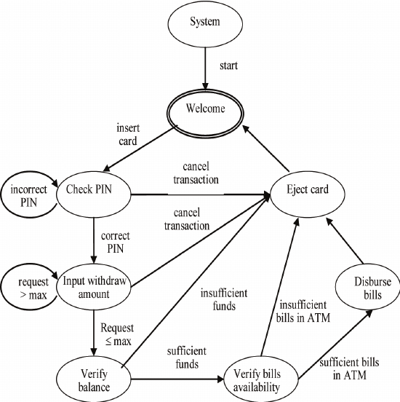
EXAMPLE#4:WITHDRAW AMOUNT FROM ATM?

Slide 10


